Slide 1
Blockchain Technology
Beni Iyaka H00181266
bi34@hw.ac.uk
MSc Software Engineering
2016 - 2017

Slide 2
Outline
What is Blockchain Technology?
Overview
History
Characteristics
Description
Principles
Benefits
Challenges
Blockchain Technology as a Network
Blockchain technology Evolution
Further Readings

Slide 3
What is
Blockchain Technology?

Slide 4
A way to structure data and the foundation of cryptocurrencies like Bitcoin.
A transactional application that establishes trust, accountability and transparency while observing the business process.
A process used to vastly reduce cost and complexity of cross enterprise processes.
Source: Wright, Aaron, and Primavera De Filippi. "Decentralized blockchain technology and the rise of lex cryptographia." Available at SSRN 2580664(2015).

Slide 5
A transactional method used to monitor transactions without the use of a 3rd party.
Blockchain technology is a protocol for building an immutable historical record of transaction.
Source: Wright, Aaron, and Primavera De Filippi. "Decentralized blockchain technology and the rise of lex cryptographia." Available at SSRN 2580664(2015).

Slide 6
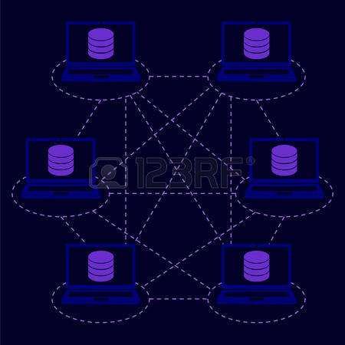
What is Blockchain?
Source: http://www.centrodeinnovacionbbva.com/sites/default/files/blockchain-cibbva.jpg

Slide 7
Overview
of
Blockchain Technology

Slide 8
Blockchain is a combination of old system ways in a new way. Of which some of these ways are:
Cryptographic signatures.
Peer to Peer Network.
Hashing functions.
Public/Private key cryptography.
Elliptic curve cryptography.
Distributed System.
Pilkington, M., 2016. Blockchain technology: principles and applications. Research Handbook on Digital Transformations, edited by F. Xavier Olleros and Majlinda Zhegu. Edward Elgar.

Slide 9
History

Slide 10
The first block was invented in 2009.
Blockchain technology was invented by Satoshi Nakamoto which is the fiction name used.
Blockchain Technology was then adopted by Crypto-geeks.
In december 2010, Satoshi posted something which turned out to be his/her last post.
Pilkington, M., 2016. Blockchain technology: principles and applications. Research Handbook on Digital Transformations, edited by F. Xavier Olleros and Majlinda Zhegu. Edward Elgar.

Slide 11
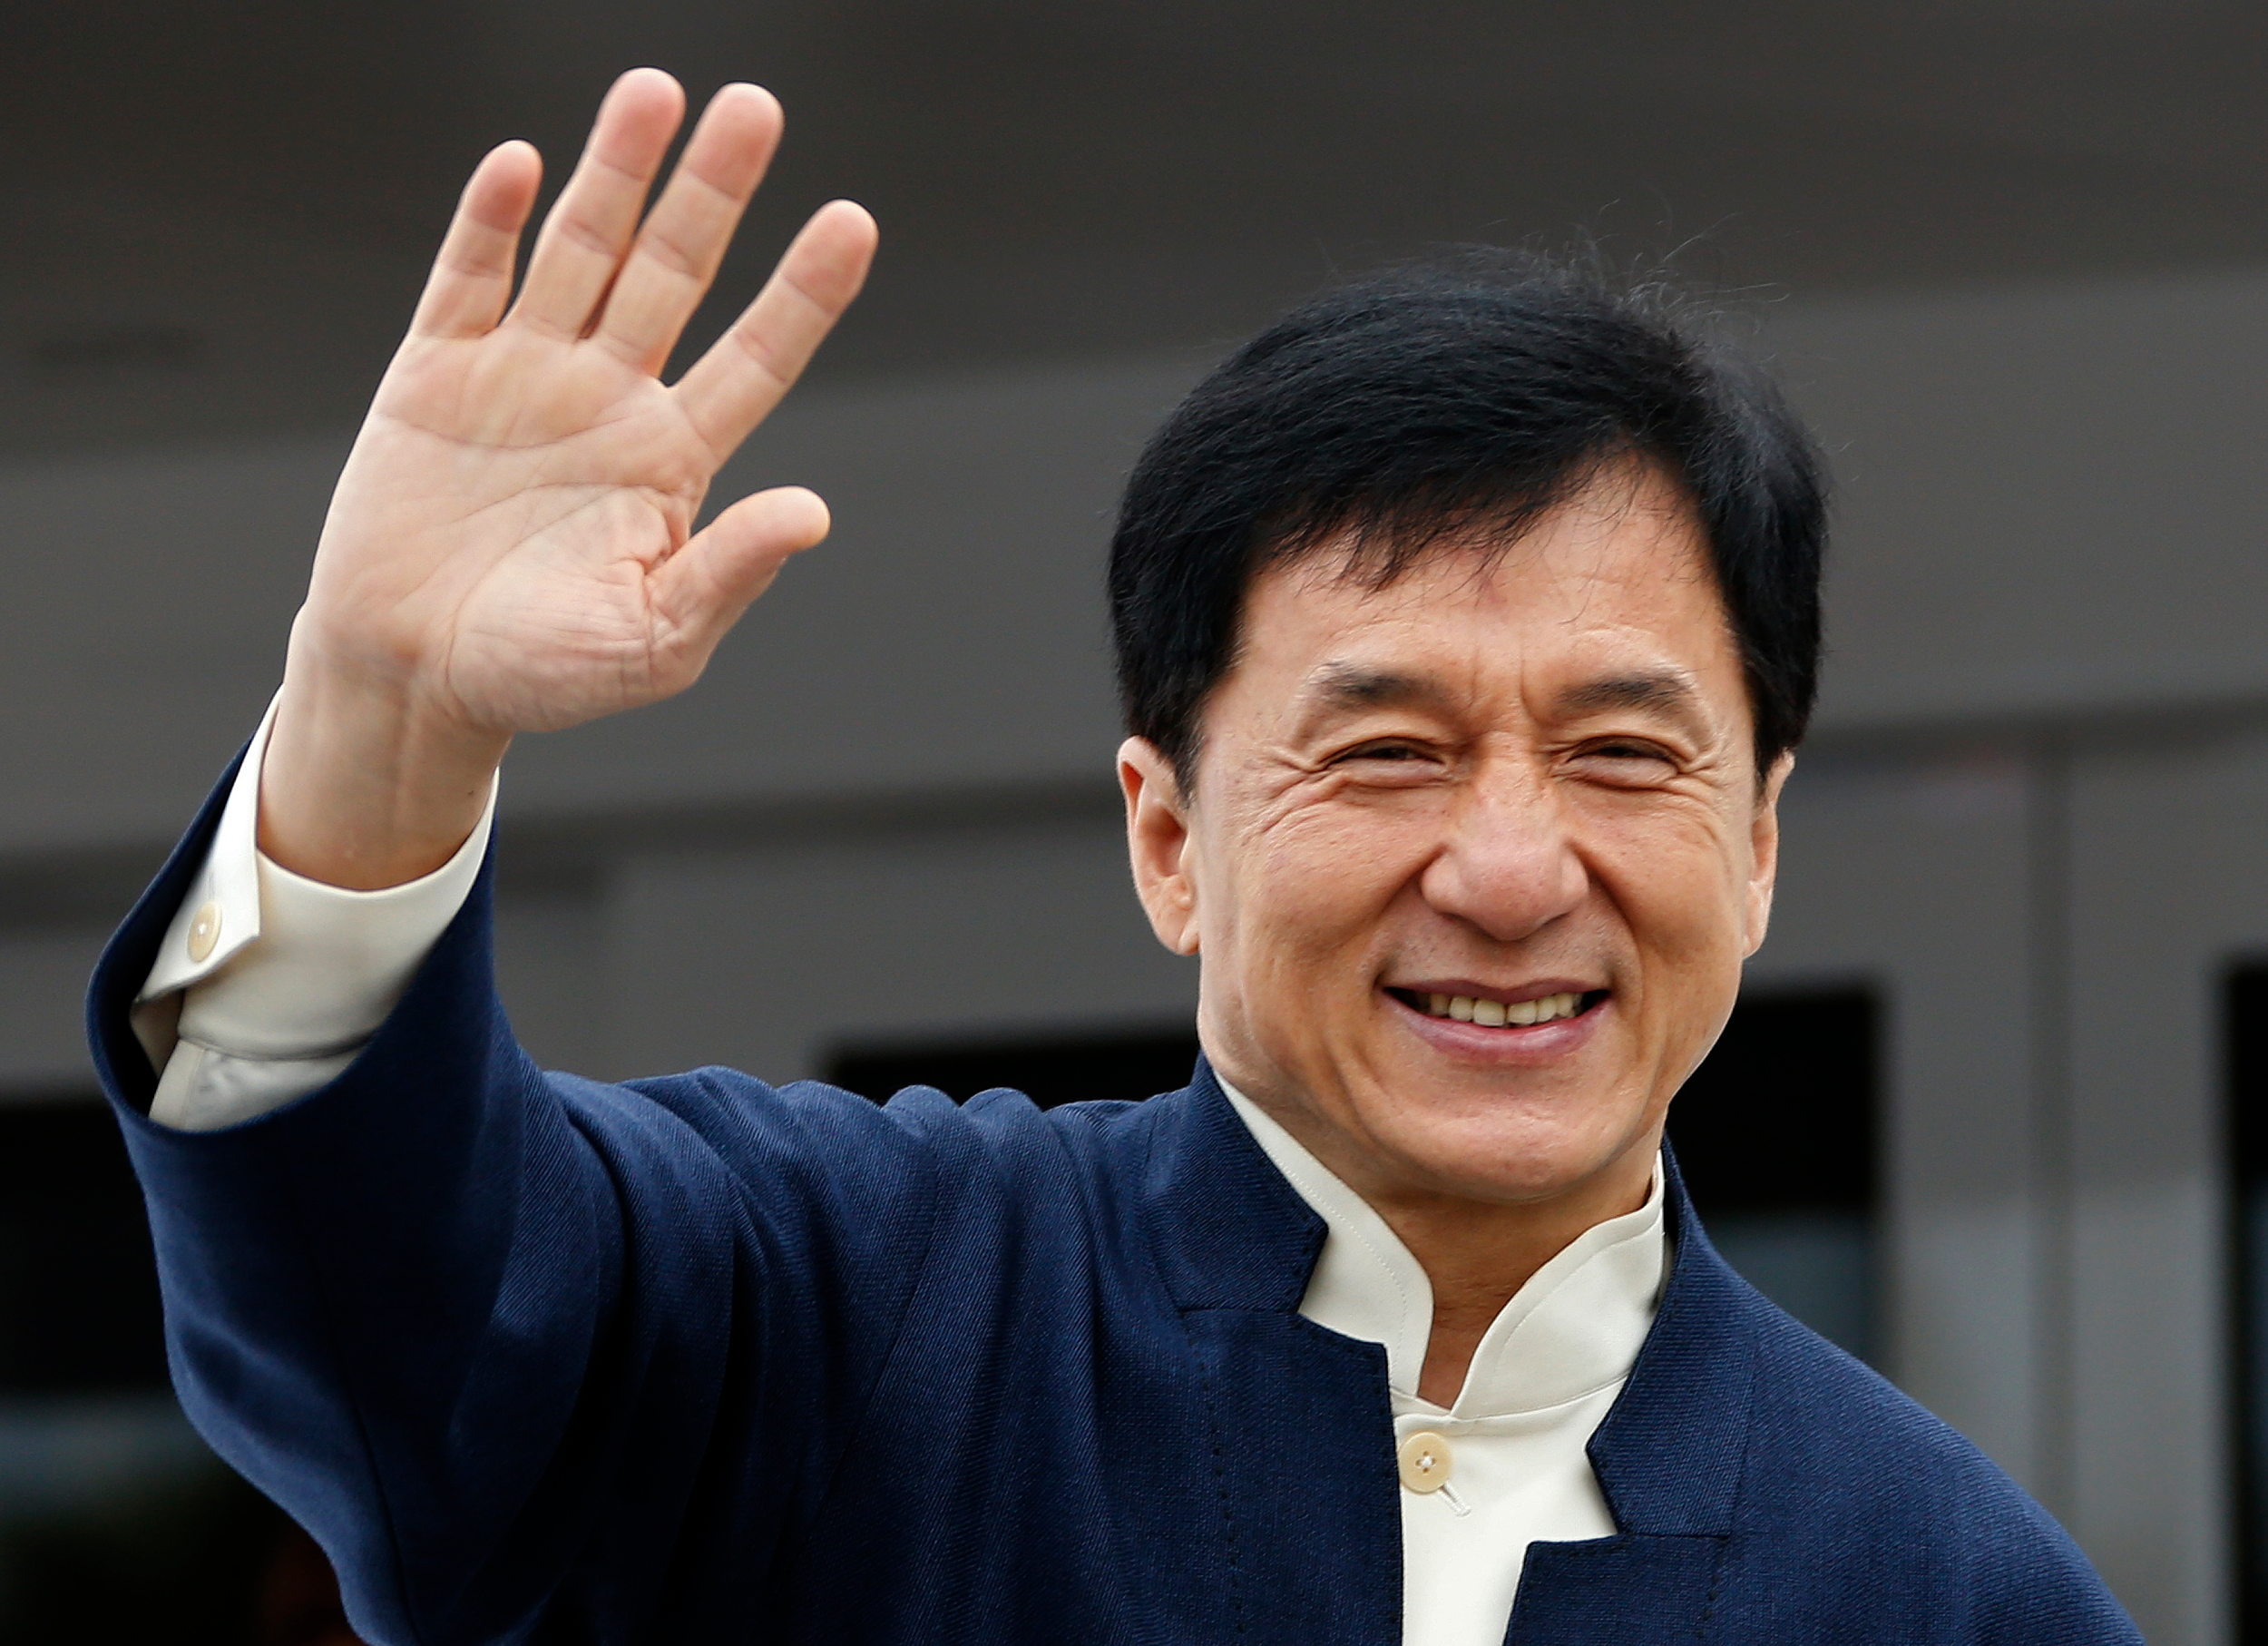
Maybe his name is Satoshi Nakamoto.
But I don’t think so.
He mostly doesn’t know how to code unless code of fighting
I’m sure he knows nothings about Cryptography.

Slide 12
Characteristics
of
Blockchain Technology

Slide 13
Durability
Blockchain Technology is safe for long term storage since it can be moved around.
Portability
Blockchain Technology can be moved around resulting to it being durable.
Divisibility
Blockchain Technology can be used in small amount

Slide 14
Limited Supply
Blockchain Technology will help maintain value of our resources because it allows us to have small equal amount.
Acceptability
Blockchain Technology allows us to spend it around.
Uniformity
Blockchain Technology can be used in small amounts, those small amounts are equal.

Slide 15
Description
of
Blockchain Technology

Slide 16

No third party required
Blockchain Technology builds a direct link between consumers and suppliers by removing the need of a third party. Because:
* When a third party is required, the risk of fraud by the 3rd party is high.
* When the flow is too complex, the more third parties are required. E.g.: Banks, Transaction.
* The easier it is to do a transaction, the more people transact.

Slide 17

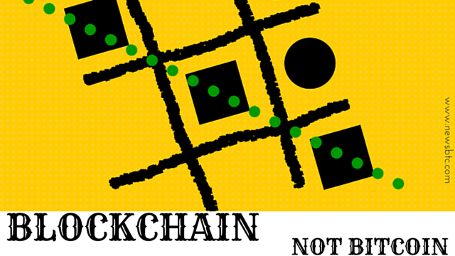
Blockchain Technology can reduce liquidity by giving us a way to reduce friction through the mathematical validation of transaction.
Most people think of it as the technology behind Bitcoin; but blockchains technology potential extend far beyond digital currencies.
https://encrypted-tbn0.gstatic.com/images?q=tbn:ANd9GcRWJAfw05yA102xB1YRKPpYWt0C7ldmIZr4X9S1Hvvm-VRlqtnP
https://encrypted-tbn1.gstatic.com/images?q=tbn:ANd9GcQeqpxvozynBitJFkcH0_as_7KoaLnaFY016JjjKWXHnz63gWsL

Slide 18
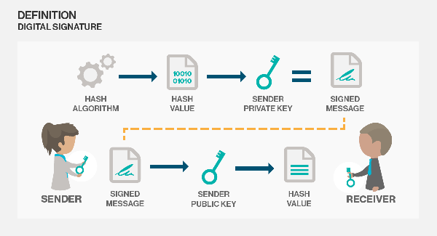
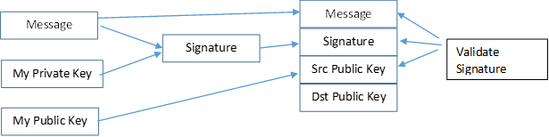
Blockchain Technology helps us use Digital signature:
* To verify possession of private key.
* To verify that messages came from the right person.
* Verify that messages haven’t been changed or tampered with.
* Allow fine grained version control of documents and contracts.
Source: Mainelli, M. and von Gunten, C., 2014. Chain Of A Lifetime: How Blockchain Technology Might Transform Personal Insurance. Long Finance.

Slide 19
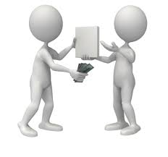
Blockchain Technology provides us with signed blocks of transactions so as:
* To preserve the sequence of transactions.
* To allow fine-grained access control at the level of a transaction.
* To create continually updated audit trials.
Source: Mainelli, M. and von Gunten, C., 2014. Chain Of A Lifetime: How Blockchain Technology Might Transform Personal Insurance. Long Finance.

Slide 20
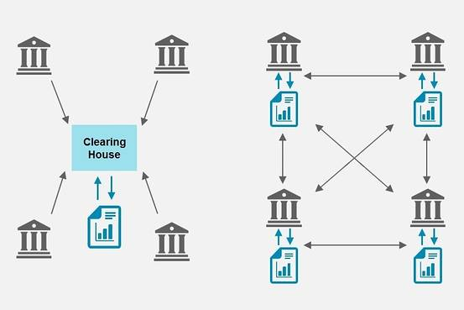
Blockchain Technology helps with distributed ledgers to:
* Establish a single version.
* Reduce or eliminate the need for centralized third parties.
* Open the door to the autonomous agents, processes and organisations implied by smart contract technology.
Source: Mainelli, M. and von Gunten, C., 2014. Chain Of A Lifetime: How Blockchain Technology Might Transform Personal Insurance. Long Finance.

Slide 21
Blockchain Technology makes us go back to the peer to peer system.
Blockchain Technology is fast compare to other technology.
No special equipment is needed while doing the transaction.
Trust a trustless system by making use of encryption system public key and private key; of which, Public key is the identity of a user in a blockchain while the private key is known by it owner only.

Slide 22
Make the transaction at minimal cost possible
Since it is a peer to peer system, no chargebacks is required.
No monthly fees.
It provides transparency to the transaction.
Remove the need of special.
Remove fraud.

Slide 23
Principles
of
Blockchain Technology

Slide 24
Blockchain makes sure that all the transactions are grouped together into a block to form a chain.
The chain represent a set of blocks linked together.
The blocks are numbered in an ascending order.
Once a block is stored, it becomes read-only.
0
1
2
3
4
Source: Mainelli, M. and von Gunten, C., 2014. Chain Of A Lifetime: How Blockchain Technology Might Transform Personal Insurance. Long Finance.

Slide 25
Blockchain makes sure that all the transactions are grouped together into a block to form a chain.
The chain represent a set of blocks linked together.
The blocks are numbered in an ascending order.
Once a block is stored, it becomes read-only.
0
1
2
3
4
Source: Mainelli, M. and von Gunten, C., 2014. Chain Of A Lifetime: How Blockchain Technology Might Transform Personal Insurance. Long Finance.

Slide 26
To create a new block, blockchain technology uses a process called mining which automatically creates a block on a certain time average.
For bitcoin, the average time is 10minutes.

Slide 27
Benefits
of
Blockchain Technology

Slide 28
Empowered users
Blockchain Technology technology gives the user full control of their information and transactions.
Disintermediation and trustless exchange
Blockchain Technology allows two concerned parties to make exchange without an intermediate of a 3rd party; resulting to a strong reduction or elimination of any counterparty risk.
Source: Mainelli, M. and von Gunten, C., 2014. Chain Of A Lifetime: How Blockchain Technology Might Transform Personal Insurance. Long Finance.

Slide 29
Durability, Reliability and Lastingness
Blockchain Technology is categorized as a Decentralized network; therefore, there is no central point of failure and it is better editable to resist malicious attacks.
Source: Mainelli, M. and von Gunten, C., 2014. Chain Of A Lifetime: How Blockchain Technology Might Transform Personal Insurance. Long Finance.

Slide 30
Faster Transaction
Transaction within Banks can take days for clearing and mostly after working hours. Blockchain Technology was designed to reduce transaction times and also to be processed 24/7.
Transparency and Immutability
Blockchain Technology provides transparency by providing a publicly viewable changes to public blockchain.
Source: Mainelli, M. and von Gunten, C., 2014. Chain Of A Lifetime: How Blockchain Technology Might Transform Personal Insurance. Long Finance.

Slide 31
Some challenges
that comes with
Blockchain Technology

Slide 32
Lack of privacy
Since Blockchain Technology provides transparency, all the user's transactions are out there for people to see.
Lack of Scalability
Since Blockchain Technology provides a peer to peer transaction, it is quite difficult to perform a peer to peer transaction with someone in another country/continent without the need of a 3rd party like a Bank.
Mainelli, M. and von Gunten, C., 2014. Chain Of A Lifetime: How Blockchain Technology Might Transform Personal Insurance. Long Finance.

Slide 33
Blockchain Technology provides digital tokens which are like money, it can be locked up with different multi signature security but once someone else get access to them, they are gone.
Mainelli, M. and von Gunten, C., 2014. Chain Of A Lifetime: How Blockchain Technology Might Transform Personal Insurance. Long Finance.

Slide 34
Blockchain Technology
as a
Network

Slide 35
There a 3 types of network namely:
Centralized network
Decentralised Network
Distributed Network
Mainelli, M. and von Gunten, C., 2014. Chain Of A Lifetime: How Blockchain Technology Might Transform Personal Insurance. Long Finance.

Slide 36
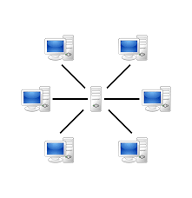
Centralised Network
This is a Type of network whereby all users are connected to a central server, which is acting as the heart of the network.
Mainelli, M. and von Gunten, C., 2014. Chain Of A Lifetime: How Blockchain Technology Might Transform Personal Insurance. Long Finance.

Slide 37
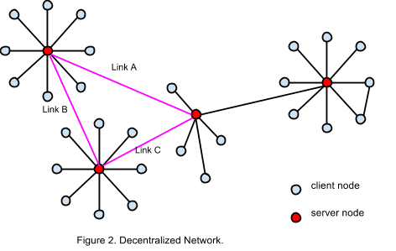
Decentralised Network
This is a combination of centralised and distributed network because each node in the network is connected to their network server and also to the server in other networks.
Mainelli, M. and von Gunten, C., 2014. Chain Of A Lifetime: How Blockchain Technology Might Transform Personal Insurance. Long Finance.

Slide 38
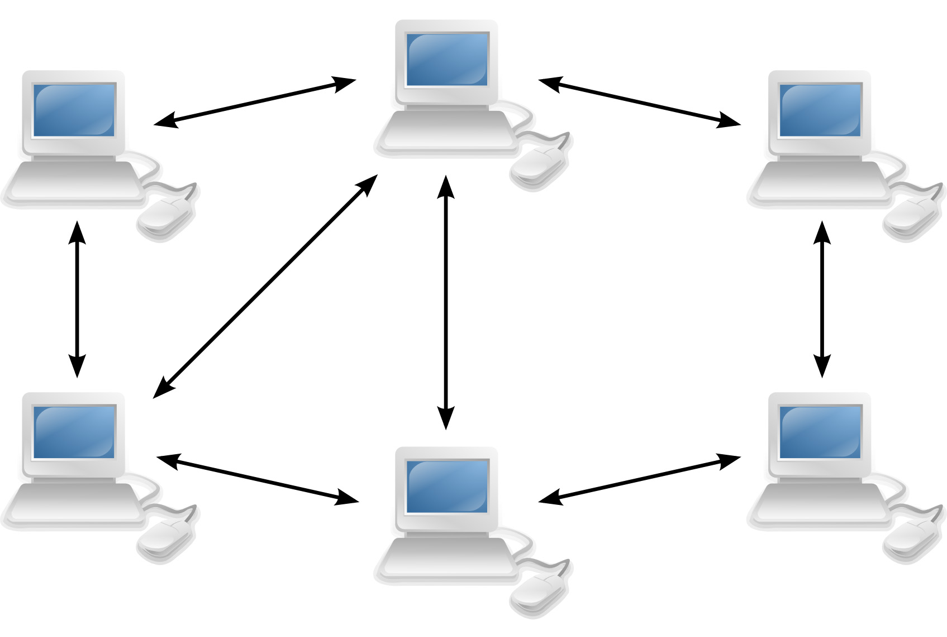
Distributed Network
This is a type of network whereby all the nodes within the network are connected with one another.
Mainelli, M. and von Gunten, C., 2014. Chain Of A Lifetime: How Blockchain Technology Might Transform Personal Insurance. Long Finance.

Slide 39
Network Evolution

Slide 40
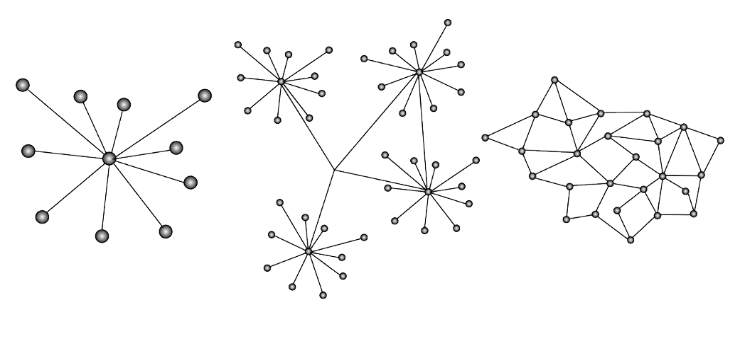
iii) distributed network
i) centralized Network
ii) decentralized network
Mainelli, M. and von Gunten, C., 2014. Chain Of A Lifetime: How Blockchain Technology Might Transform Personal Insurance. Long Finance.

Slide 41
i) centralized
iii) distributed
ii) decentralized
Mainelli, M. and von Gunten, C., 2014. Chain Of A Lifetime: How Blockchain Technology Might Transform Personal Insurance. Long Finance.

Slide 42
i) centralized
iii) distributed
ii) decentralized
Mainelli, M. and von Gunten, C., 2014. Chain Of A Lifetime: How Blockchain Technology Might Transform Personal Insurance. Long Finance.

Slide 43
i) centralized
iii) distributed
ii) decentralized
Mainelli, M. and von Gunten, C., 2014. Chain Of A Lifetime: How Blockchain Technology Might Transform Personal Insurance. Long Finance.

Slide 44
i) centralized
iii) distributed
ii) decentralized
Mainelli, M. and von Gunten, C., 2014. Chain Of A Lifetime: How Blockchain Technology Might Transform Personal Insurance. Long Finance.

Slide 45
i) centralized
iii) distributed
ii) decentralized
Mainelli, M. and von Gunten, C., 2014. Chain Of A Lifetime: How Blockchain Technology Might Transform Personal Insurance. Long Finance.

Slide 46
i) centralized
iii) distributed
ii) decentralized
Mainelli, M. and von Gunten, C., 2014. Chain Of A Lifetime: How Blockchain Technology Might Transform Personal Insurance. Long Finance.

Slide 47
i) centralized
iii) distributed
ii) decentralized
Mainelli, M. and von Gunten, C., 2014. Chain Of A Lifetime: How Blockchain Technology Might Transform Personal Insurance. Long Finance.

Slide 48
i) centralized
iii) distributed
ii) decentralized
Mainelli, M. and von Gunten, C., 2014. Chain Of A Lifetime: How Blockchain Technology Might Transform Personal Insurance. Long Finance.

Slide 49
i) centralized
iii) distributed
ii) decentralized
Mainelli, M. and von Gunten, C., 2014. Chain Of A Lifetime: How Blockchain Technology Might Transform Personal Insurance. Long Finance.

Slide 50


Blockchain Technology
the second coming
of
the Internet

Slide 51
Blockchain Technology can be seen as a database or a giant network known as a distributed leger which captures ownership, value and also permits anyone who can access the network to view and take part.
In a distributed network, the network is updated and verified through the agreement of everybody involved. When somethings is added, it can not be changed and if it looks valid to everyone then, the update is approved.

Slide 52
Compared to the internet in the 90’s, Blockchain Technology has a similar investment and a similar version of potential users.
Blockchain Technology was built for finance first but now it has been used in different aspects.
Will be discussed further at a later stage….

Slide 53
Evolution
of
Blockchain Technology network

Slide 54
Bitcoin, Litecoin, dogecoin are known to be the 1st generation of Blockchain Technology.
1st generation network just transfer value.
Most of the Blockchain Technology improved technologies are built upon existing blockchains by
Mainelli, M. and von Gunten, C., 2014. Chain Of A Lifetime: How Blockchain Technology Might Transform Personal Insurance. Long Finance.

Slide 55
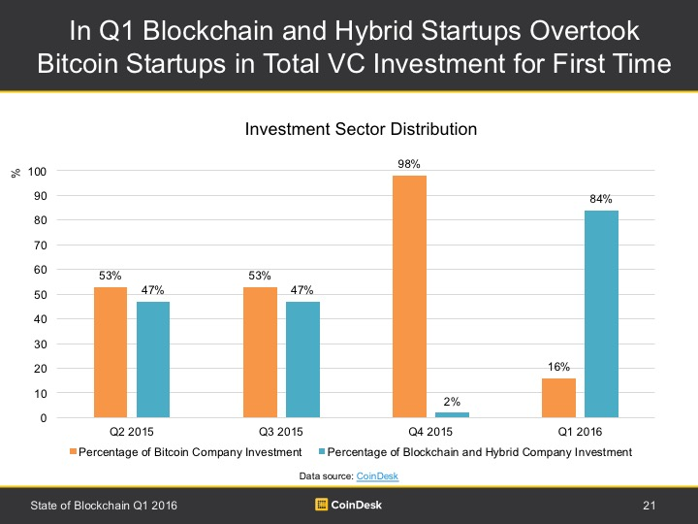

Slide 56
Further readings
https://bitsonblocks.net/2016/02/01/a-gentle-introduction-to-smart-contracts/
https://bitsonblocks.net/2016/05/09/confused-by-blockchains-revolution-vs-evolution/
https://bitsonblocks.net/2015/12/01/the-pros-and-cons-of-internal-blockchains/

Slide 57
Further readings
https://bitsonblocks.net/2015/09/28/a-gentle-introduction-to-digital-tokens/
https://bitsonblocks.net/2015/09/21/a-gentle-introduction-to-bitcoin-mining/
https://bitsonblocks.net/2016/02/01/a-gentle-introduction-to-smart-contracts/

